Slide 1
Truck Parking
MSP Dataset
DS-701
Ian Delannes-Molka

Slide 2
Goal
Identify risky zones where truck parking occurs along main roadways
HOW:
Identify CMV related crashes in MSP data
Use distance-based spatial matching for direction validation
Find risky zones around truck parking lots by using crash rates
Utilize three datasets:
Maryland State Police Crash data
Maryland TMC 2023 data
MD Truck parking data

Slide 3
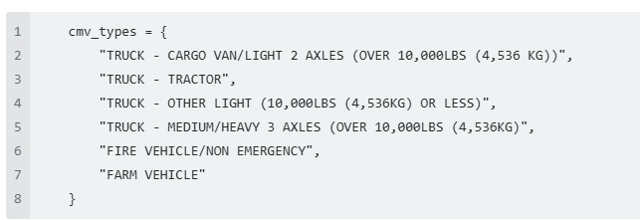
CMV
Used scoring logic to identify potential cmv matches
df['cmv_score'] = (
df['vehicle_type_cmv'] * 10 +
df['harmful_event_cmv_flag'] * 10 +
df['nlp_cmv_match'] * 3 +
df['vehicle_make_model_cmv'] * 8)
>=10 means CMV Involved

Slide 4
CMV Involvement
False (Not Involved) 27865 (TN+FN)
True (CMV Involved) 2796 (TP+FP)
Label Type | Count
True Positives (TP) | 2,587
False Positives (FP) | 209
True Negatives (TN) | 27865
False Negatives (FN) | 0

Slide 5
Adding direction
Added direction using MD tmc 2023 geojson file and conflated with truck parking geojson.
Truck Parking Geojson file needed fixing. Merged polygon and point based on created objected
4 direction based columns from msp and 2 direction based columns from tmc file.
Used a combination of majority matching and single column matching for results
Total 31058- within 50 meters of a truck parking zone
 | Direction Field | Match | Mismatch | Unknown | Percentage
Step 1 | milepointdirection | 11513 | 16210 | 3335 | 37.1%
Step 1 | lanedirection | 11903 | 15763 | 3382 | 38.3%
Step 1 | goingdirection | 11805 | 15830 | 3423 | 38.0%
Step 1 | continuedirection | 11666 | 15944 | 3448 | 37.6%
Step 2 | Majority (3-of-4 rule) | 12163 | 14813 | 3082 | 39.2%
Step 3 | Majority extended | 17442 | 10534 | 3082 | 56.16%
Step 4 | Other side (3-4 Majority) | 24470 | 3506 | 3082 | 78.8%

Slide 6
Conflating with log mile data 30661 incidents within 50 meters of truck parking zone
Step Description | Match | Mismatch | Unknown | Match %
Step 1 - milepointdirection_match | 11,496 | 16,218 | 2,947 | 37.5%
Step 1 - lanedirection_match | 11,890 | 15,766 | 3,005 | 38.8%
Step 1 - logmile_dir_match | 8,992 | 18,542 | 3,127 | 29.3%
Step 1 - goingdirection_match | 11,702 | 15,697 | 3,262 | 38.2%
Step 2 - Majority Rule (3 of 4 or 2/4 w/ lane) | 11,724 | 16,013 | 2,924 | 38.2%
Step 3 - Any Match Fallback (1 of 4) | 19,169 | 8,568 | 2,924 | 62.5%
Step 4 – 20 meter buffer to Parking lot, Off-Ramp, or On-Ramp Auto-Match (Final) | 22,076 | 6,441 | 2,144 | 72.0%

Slide 7
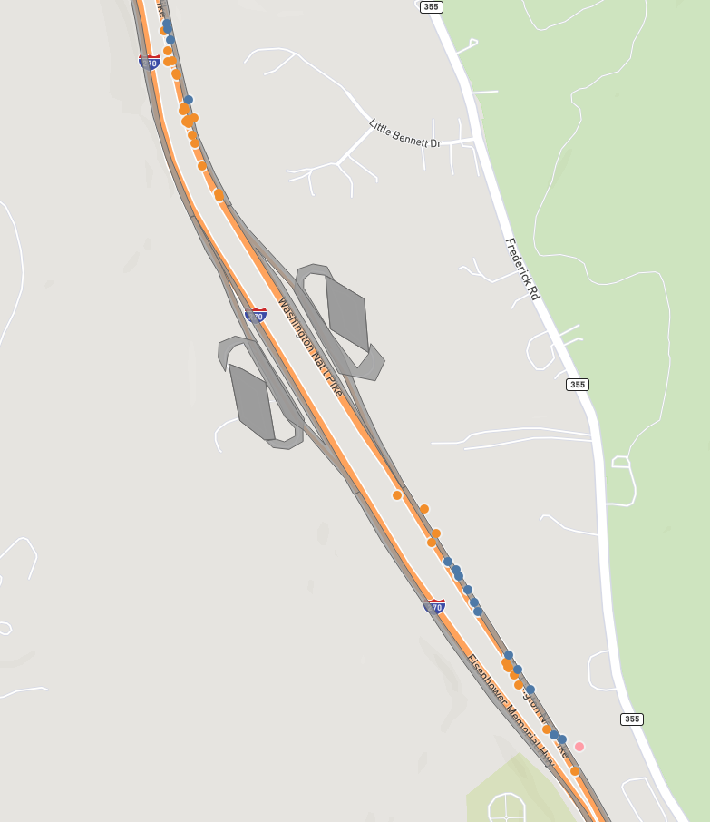
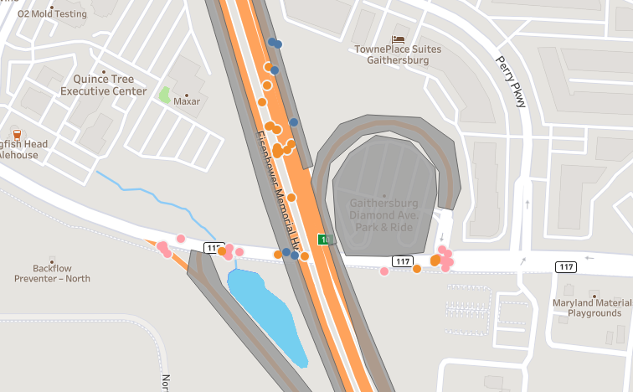
Problems
Parking lots not directly on highway or next to off ramp have many directional mis matches since the roads they are on are technically not associated with the main line.

Slide 8
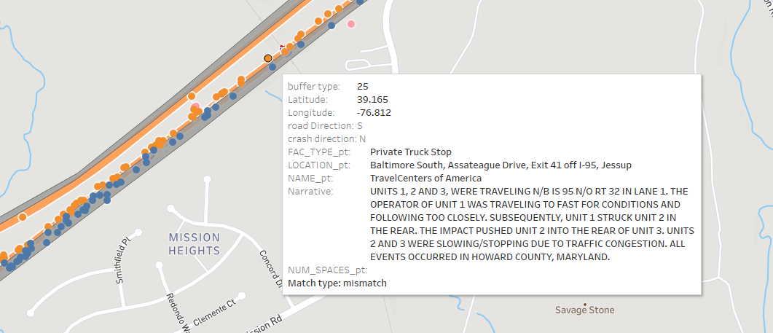
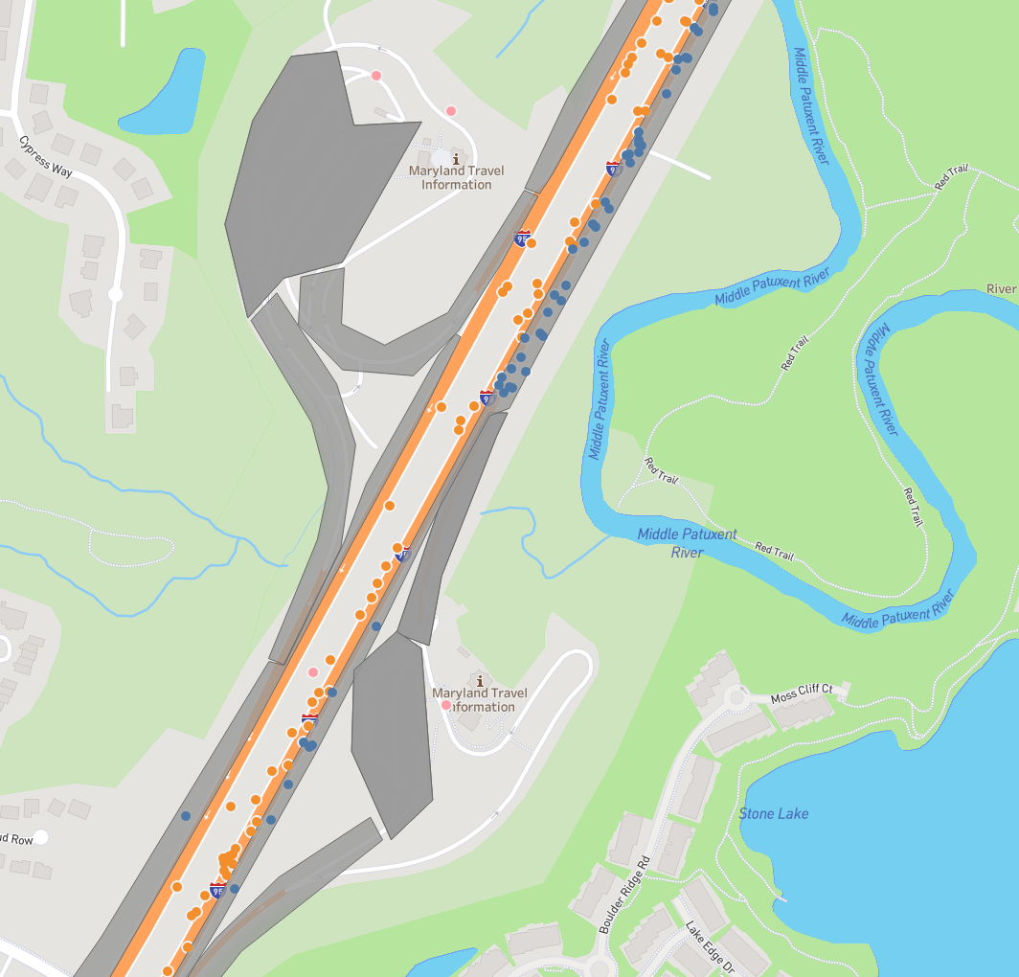
Mislabeled directional points
Many zones on the mainlines are mis-labeled in direction
Some crash coordinates are unreliable and are too close to the median to justify 25-50 meter buffers. How accurate are coordinate points for car crashes

Slide 9
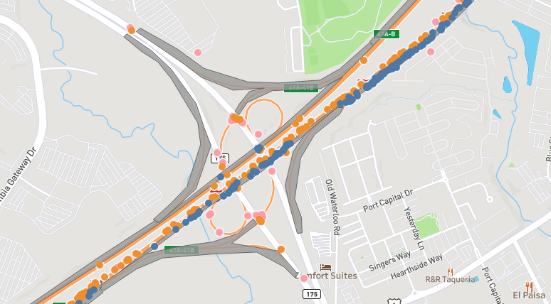
Parking lots with exits on the north and south sides
Use upstream and downstream to determine direction for the entire lot, but if the exit to the parking lot is accessible from the north and southbound lanes then there may be issues with direction matching

Slide 10
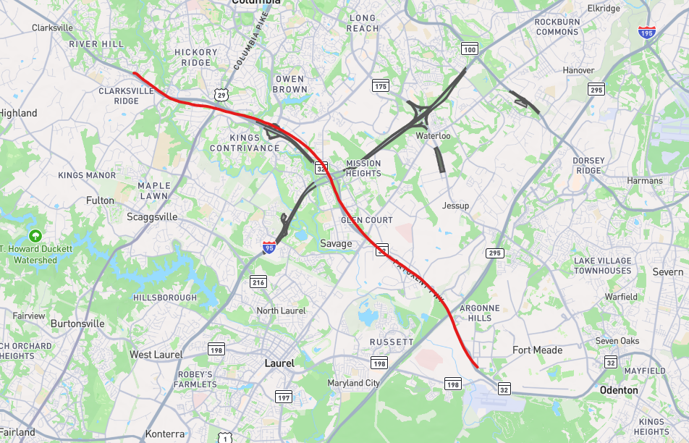
Manual direction adding Exceptions
Parking Lots that have exit and on ramps that runs both N/S and E/W- manual change made based on the majority of crash directions in crash reports. For example in a cardinal direction e/w officers majorly put N/S since eventually it turns into N/S but is just E/W for a small bit
Road ways that run N/S but have segments that will run E/W= manual change made. Accounting for officer directional mistakes. N/W or S/E

Slide 11
Final Conflation with manual direction Excluded rows with nearest_zone='parking lot'. Remaining rows: 29019
Comparison | Match | Mismatch | Unknown | Match % of Total
milepointdirection vs Direction | 14,837 | 14,023 | 159 | 51.1%
lanedirection vs Direction | 16,627 | 12,205 | 187 | 57.3%
logmile_dir vs Direction | 16,254 | 12,433 | 332 | 56.0%
goingdirection vs Direction | 16,370 | 12,164 | 485 | 56.4%
Step 1 - Majority Match (¾ with Lane direction tie breaker) | 16,520 | 12,366 | 133 | 56.9%
Step 2 - Final Any-Match Override | 24,940 | 3,946 | 133 | 85.9%

Slide 12
Field meanings
Field | Derived From | Type | Real-world vs System
milepointdirection | Milepoint system | Road system logic | System-based
logmile_dir | Log mile inventory | MDOT Road inventory | System-based
goingdirection | Officer/driver input | Observed behavior | Real-world
lanedirection | Lane-level analysis | Traffic flow | Real-world

Slide 13
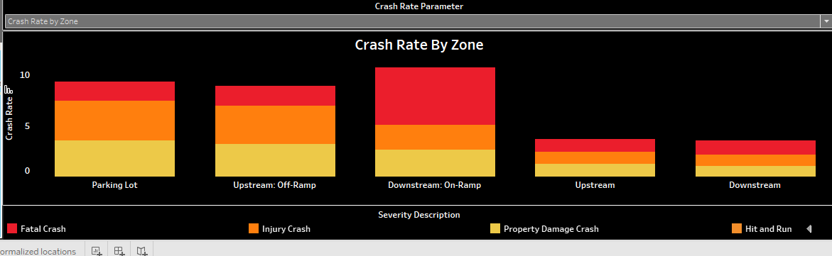
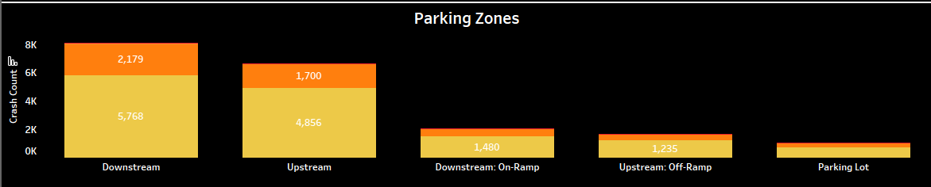
Adding crash rate
From Inrix 2019 database
Conflated with TMCs

Slide 14
H test set up
Selected 3 random Truck Parking Zones
Created 3 new control lots with upstream, downstream, and on/off ramps with same characteristics (number of lanes, speed limit, road name, road curvature, type of on/off ramp)
Conflated all zones; test and control

Slide 15
Hypothesis testing
1. Poisson Test
What it tests: Whether the observed crash count in one group (e.g., truck zone) is significantly higher than expected based on another group (e.g., control) given exposure (VMT).
Why it works: Crash data are count-based, and VMT is used as the exposure variable.
Assumptions:
Events occur independently.
The rate is constant over time/space.
The data follows a Poisson distribution.
Used
When to use: Comparing rates of rare events (e.g., crashes per mile) between groups.
2. Z-Test for Two Proportions (Z-Test for Rates)
What it tests: Whether two rates (crash counts normalized by VMT) are significantly different.
Why it works: Crash rates are derived from counts, and we have large enough sample sizes to approximate a normal distribution for the test.
Assumptions:
Large enough counts for normal approximation.
Independent observations.
Used
When to use: Comparing two normalized rates (e.g., crashes per VMT) from independent samples.
Mean does not equal variance in this case, switched to Negative Binomial regression model which is good when using over dispersed data, which gave the same results as Poisson Testing

Slide 16
TESTS NOT WELL-SUITED FOR OUR SCENARIO
3. One-Sample T-Test
What it tests: Whether the mean of a single sample differs from a known/population mean.
Why it doesn’t work: We are not comparing a single sample to a fixed population value; we're comparing two independent groups with count-based rates.
Not used
4. Independent Samples T-Test (Two-Sample T-Test)
What it tests: Whether the means of two continuous variables are different.
Why it doesn’t work: The data are crash counts and rates (not continuous variables like weight, time, etc.), and crash rates are not normally distributed.
T-test assumptions violated:
Normal distribution
Equal variance
Not used

Slide 17
5. Paired Samples T-Test
What it tests: Whether the mean difference between paired observations is significantly different from zero.
Why it doesn’t work: we don’t have natural pairs of crash observations (e.g., before/after or same unit tracked over time); we have aggregated counts by zone.
Not used
6. ANOVA (Analysis of Variance)
What it tests: Whether more than two groups have different means.
Why it doesn’t work: crash rate comparisons are always between two groups (truck zone vs control zone). Also, ANOVA assumes normality and continuous dependent variables, which crash rates don’t satisfy well.
Not used
7. Mann-Whitney U Test (Wilcoxon Rank Sum)
What it tests: Whether one group tends to have higher values than another, based on ranks.
Why it doesn’t work: This is for continuous or ordinal data; your data are counts. Also not ideal for comparing normalized rates.
Not used

Slide 18
In zone vs out zone Z test + Poisson
OBJECTID | Control | Truck Crashes | Truck VMT | Truck Rate | Control Crashes | Control VMT | Control Rate | Poisson P-val | Z-test Z | Z-test P-val | Result
61 | CTRL002 | 2072 | 666.25 | 3.11 | 2642 | 1386.16 | 1.91 | 0.000000 | 18.74 | 0.000000 | Both significant
9 | CTRL001 | 612 | 295.42 | 2.07 | 596 | 61.89 | 9.63 | 1.000000 | -15.32 | 1.000000 | No significant diff.
12 | CTRL003 | 1122 | 353.19 | 3.18 | 566 | 241.07 | 2.35 | 0.000001 | 3.34 | 0.000422 | Both significant

Slide 19
OBJECTID 9 vs CTRL001- Poisson + z-test
Zone Type | Truck Crashes | Truck VMT | Rate | Control Crashes | Control VMT | Rate | Poisson P-val | Z-test Z | Z-test P-val | Result
Upstream | 278 | 166.32 | 1.67 | 155 | 18.46 | 8.39 | 1.000000 | -16.10 | 1.000000 | No significant difference
Downstream | 169 | 106.22 | 1.59 | 222 | 26.54 | 8.37 | 1.000000 | -16.26 | 1.000000 | No significant difference
Parking Lot | — | — | — | — | — | — | — | — | — | Insufficient data
Upstream: Off-Ramp | 78 | 8.20 | 9.51 | 145 | 11.59 | 12.51 | 0.994890 | -1.95 | 0.9743 | No significant difference
Downstream: On-Ramp | 49 | 6.84 | 7.16 | 74 | 5.29 | 13.99 | 1.000000 | -3.64 | 0.9999 | No significant difference

Slide 20
OBJECTID 61 vs CTRL002 - Poisson + z-test
Zone Type | Truck Crashes | Truck VMT | Rate | Control Crashes | Control VMT | Rate | Poisson P-val | Z-test Z | Z-test P-val | Result
Upstream | 816 | 299.73 | 2.72 | 760 | 231.98 | 3.28 | 1.000000 | -3.67 | 0.9999 | No significant difference
Downstream | 824 | 268.78 | 3.07 | 863 | 1009.62 | 0.85 | 0.000000 | 26.22 | 0.000000 | Both significant
Parking Lot | — | — | — | — | — | — | — | — | — | Insufficient data
Upstream: Off-Ramp | 208 | 36.89 | 5.64 | 663 | 122.08 | 5.43 | 0.303942 | 0.47 | 0.3189 | No significant difference
Downstream: On-Ramp | 189 | 57.48 | 3.29 | 356 | 22.48 | 15.84 | 1.000000 | -17.47 | 1.000000 | No significant difference

Slide 21
OBJECTID 12 vs CTRL003 - Poisson + z-test
Zone Type | Truck Crashes | Truck VMT | Rate | Control Crashes | Control VMT | Rate | Poisson P-val | Z-test Z | Z-test P-val | Result
Upstream | 493 | 144.28 | 3.42 | 196 | 69.79 | 2.81 | 0.000013 | 2.32 | 0.0101 | Both significant
Downstream | 403 | 193.59 | 2.08 | 182 | 110.77 | 1.64 | 0.000003 | 2.65 | 0.0040 | Both significant
Parking Lot | — | — | — | — | — | — | — | — | — | Insufficient data
Upstream: Off-Ramp | 34 | 5.32 | 6.40 | 102 | 20.07 | 5.08 | 0.109134 | 1.16 | 0.1232 | No significant difference
Downstream: On-Ramp | 104 | 7.21 | 14.43 | 86 | 40.45 | 2.13 | 0.000000 | 13.14 | 0.000000 | Both significant

Slide 22
Negative Binomial Model
OBJECTID | Group Comparison | Truck Coefficient | p-value | Significance | Interpretation
61 | Truck > Control | +0.0317 | 0.446 | Not sig. | No significant difference in crash rate
9 | Truck < Control | –1.2692 | 0.000 | Significant | Truck zone has a lower crash rate
12 | Truck > Control | +0.3623 | 0.000 | Significant | Truck zone has a higher crash rate

Slide 23
Negative Binomial Model – Per Zone
Zone Type | OBJECTID vs Control | Coef Sign | P < 0.05? | Interpretation
Upstream | 61 vs CTRL002 | –0.2790 | Yes | Truck < Control
 | 9 vs CTRL001 | –1.4763 | Yes | Truck < Control
 | 12 vs CTRL003 | +0.1827 | No | No difference
Downstream | 61 vs CTRL002 | +1.4771 | Yes | Truck > Control
 | 9 vs CTRL001 | –1.5627 | Yes | Truck < Control
 | 12 vs CTRL003 | +0.2095 | No | No difference
Upstream: Off-Ramp | 61 vs CTRL002 | –0.1434 | No | No difference
 | 9 vs CTRL001 | –0.1090 | No | No difference
 | 12 vs CTRL003 | +0.3313 | No | No difference
Downstream: On-Ramp | 61 vs CTRL002 | –2.1455 | Yes | Truck < Control
 | 9 vs CTRL001 | –0.4185 | No | No difference
 | 12 vs CTRL003 | +2.1908 | Yes | Truck > Control
Parking Lot | All | — | — | One group only — model not run

Slide 24
Should severity type be removed for crash rate graphs
Should in out be included, removed or changed to new set up

Slide 25
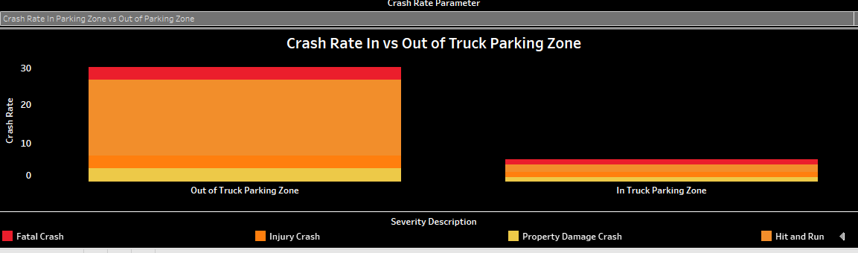
Out of truck parking zone= More than 50 meters away and less than 3 miles away.

